Slide 1
AP Computer Science A
Week 1
Code, variables, conditions and logic

Slide 2
Course Introduction
WEEK | DATE | SECTION | TOPIC
1 | 26-30 Aug |  | Code, variables, conditionals and logic
2 | 2-6 Sept |  | Loops and basics of methods
3 | 9-12 Sept |  | Methods and ArrayList
4 | 16-20 Sept |  | Basics of objects
5 | 23-27 Sept |  | Further on objects
6 | 8-11 Oct |  | Tables, searching and sorting
7 | 14-18 Oct |  | Mid-term preparation and mid-term project
8 | 21-25 Oct |  | MID-TERM EXAM
9 | 28 Oct - 1 Nov |  | HashMap
10 | 4-8 Nov |  | Interfaces
11 | 11-15 Nov |  | Exceptions and reading from files
12 | 18-22 Nov |  | Inheritance
13 | 25-29 Nov |  | Writing into files and GUI
14 | 2-6 Dec |  | Regex, iterators, enum
15 | 9-13 Dec |  | FINAL PROJECT
16 | 16-20 Dec |  | FINAL PROJECT
17 | 2-10 Jan |  | Final Exam preparation
18 | 15-16 Jan |  | FINAL EXAM

Slide 3
Course Introduction
Title | % of grade | Week
Participation | 15%
Homework | 15%
Mid-Term Exam | 20%
Final Exam | 30%
Projects | 20%
TOTAL | 100%

Slide 4
Course Introduction
Rules
Attendance
Language
Honesty
Cell Phones/Laptops

Slide 5
Setup
Go to http://cs.stefanw.co

Slide 6
Why Java?
Requirement for AP Computer Science A
Kind of old, and boring, but used everywhere
Most important concepts learned
After this course, can learn any (most) other languages in 1 hr.

Slide 7
Let’s start the course

Slide 8
The Program
Source code:
A computer program is composed of commands written in the source code. A computer generally runs commands in the source code from top to bottom and from left to right. Source code is saved in a text format and will be executed somehow.

Slide 9
The Program
Commands:
Computers execute different operations, or actions, based on the commands. For example, when printing the text "Hello world!" on the screen, it is done by the command System.out.println.

Slide 10
The Program
Semicolon:
A semicolon ; is used to separate different commands. The compiler and the interpreter both ignore line breaks in the source code, so we could write the entire program on a single line.

Slide 11
The Program
Parameters:
The information processed by a command are the parameters of a command. They are passed to the command by placing them between () brackets that follow the command name.

Slide 12
The Program
Comments:
Comments are a useful way to make notes in the source code for yourself and others. Everything on a line after two forward slashes // is treated as a comment.

Slide 13
The Program
Main program body:
The program is stored in a text file named after the program with the .java extension. For a program named Example, the file should be named Example.java.

Slide 14
Let’s practice using the IDE
Complete exercises 1-3

Slide 15
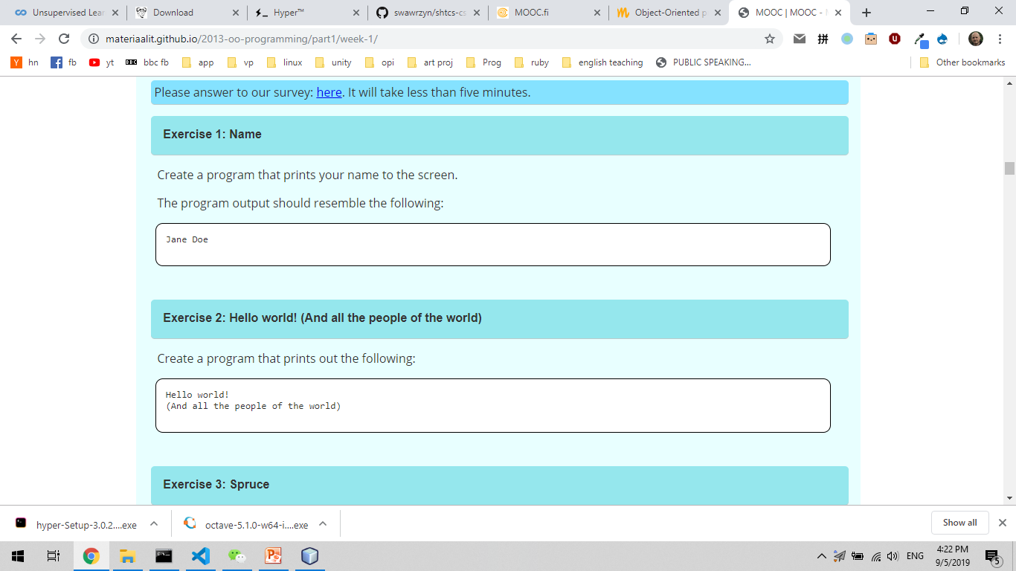
Exercise 1

Slide 16
Exercise 2

Slide 17
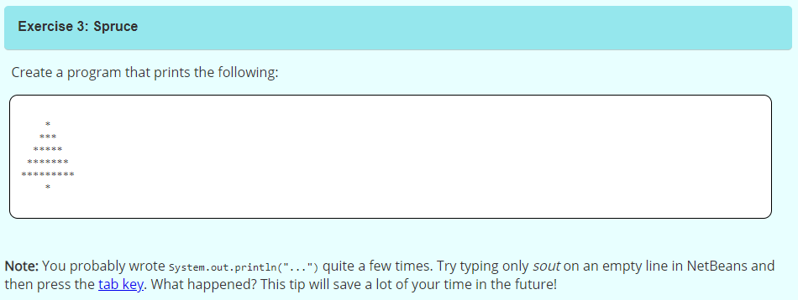
Exercise 3

Slide 18
Variables
A variable is one of the most important concepts in computer programming.
A variable should be imagined as a box in which you can store information.
The information stored in a variable always has a type.
These types include text (String), whole numbers (int), decimal numbers (double), and truth values (boolean). A value can be assigned to a variable using the equals sign (=).
Variable types are immutable.

Slide 19
Variable Names
There are certain limitations on the naming of our variables.
Variable names must not contain certain special characters like exclamation marks (!)
Variable names can contain numbers as long it does not start with one.
Variable names that have been defined before cannot be used.

Slide 20
Calculation
The calculation operations are pretty straightforward: +, -, * and /.
A more peculiar operation is the modulo operation %, which calculates the remainder of a division.
The order of operations is also pretty straightforward: the operations are calculated from left to right taking the parentheses into account.

Slide 21
Floating point numbers
Calculating the division and remainder of whole numbers is a little trickier.
A floating point number (decimal number) and integer (whole number) often get mixed up.
If all the variables in a calculation operation are integers, the end result will also be an integer.

Slide 22
Concatenation
If the + operator is used between two strings, a new string is created with the two strings combined.

Slide 23
Reading User Input
To receive user input we can use the Scanner tool.
The Scanner tool outputs string, to read integers we need to parse it using parseInt.

Slide 24
Conditional Statements
In order for the program to branch to different execution paths based on e.g. user input, we need conditional statements: if, else if, else
We can use comparison operators to determine where to go: >, <, >=, <=, ==, !=
We can compare strings with the equals command.
Code indentation is very important.

Slide 25
Logical Operations
The condition statements can be made more complicated using logical operations.
The logical operations are:
condition1 && condition2 is true if both conditions are true.
condition1 || condition2 is true if either of the conditions are true.
!condition is true if the condition is false.

Slide 26
Loops
In addition to conditions we also need repetitions.
The most simple repetition is an infinite loop using while(true)

Slide 27
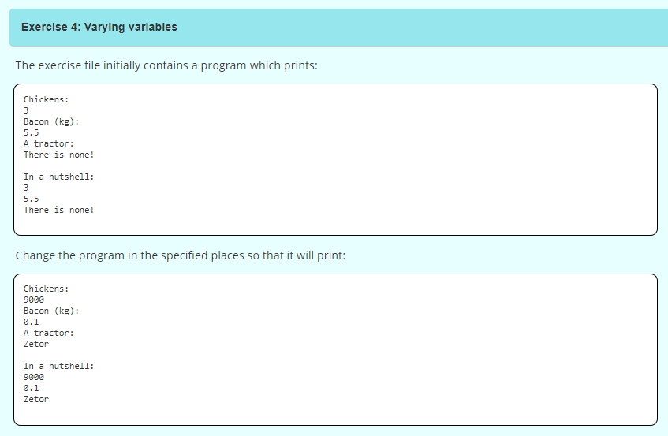
Exercise 4

Slide 28
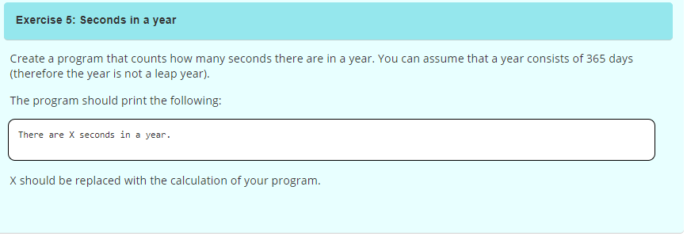
Exercise 5

Slide 29
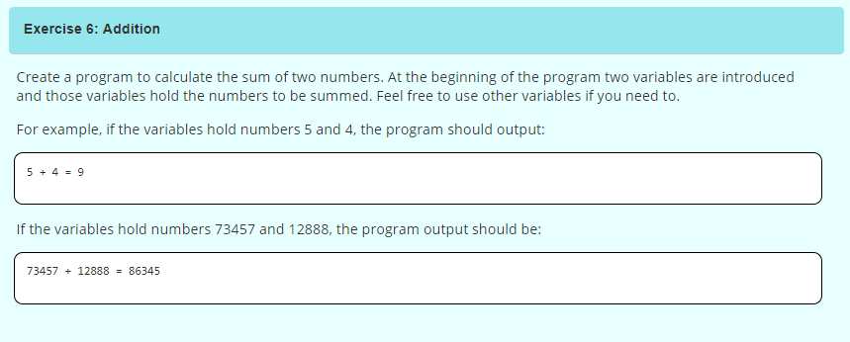
Exercise 6

Slide 30
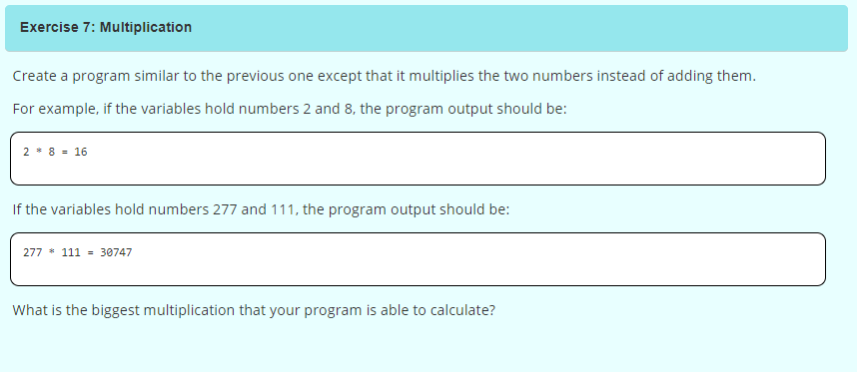
Exercise 7

Slide 31
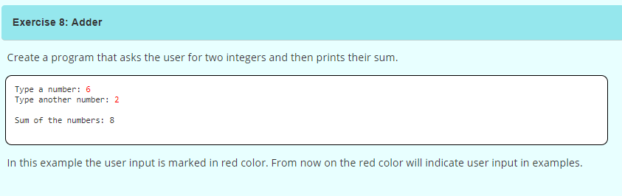
Exercise 8

Slide 32
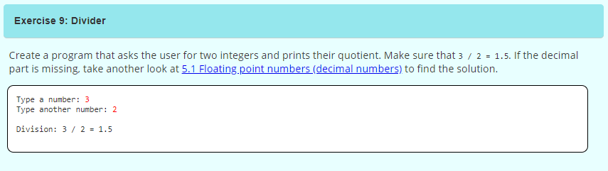
Exercise 9

Slide 33
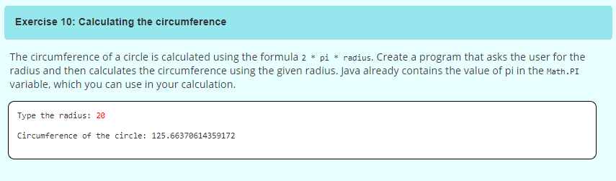
Exercise 10

Slide 34
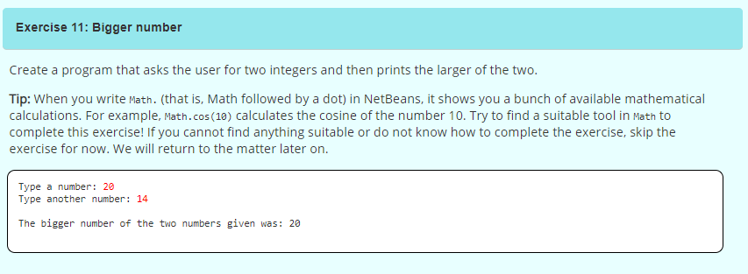
Exercise 11

Slide 35
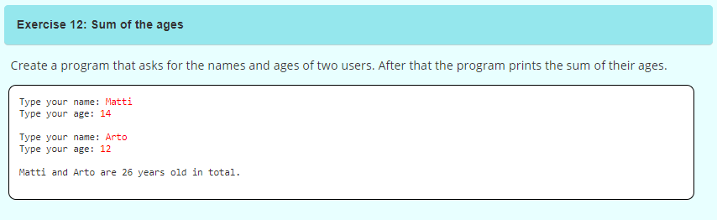
Exercise 12

